Slide 1
Week 3: Text representation II
Text Analytics
Prof Evan Katsamakas
Gabelli School of Business

Slide 2
From last week…
Tokenization
List of stopwords
Stemming
N-grams
Lab 1 (NLTK)

Slide 3
What’s important this week?
Lab 2 (NLTK)
Part-of-Speech tagging
HMM
Sentence segmentation
Sentence parsing

Slide 4
Lab 2 (Python/NLTK)

Slide 5
Due next week: Assignment 1 (HW1)
Questions?

Slide 6
Levels of text representations
Character
Words
N-grams
Part-of-speech tags
Sentence Parsing
Lexical
Syntactic
Semantic

Slide 7
Part-of-Speech
By introducing part-of-speech tags we introduce word classes enabling to differentiate the function of words in a sentence
Words that somehow ‘behave’ alike:
Appear in similar contexts
Perform similar functions in sentences
Undergo similar transformations
~9 traditional Parts of Speech
Noun, verb, adjective, article, preposition, adverb, interjection, pronoun, conjunction
Notes:
Label each word in a sentence with a POS tag
Part-of-Speech taggers are usually learned by HMM algorithm on manually tagged data
Useful for: Parsing (come to later), Information extraction (entities, relations), Speech synthesis (INsult or inSULT, overFLOW or OVERflow,
REad or reAD), Machine translation etc.

Slide 8
Why POS?
Often want to know what part of speech (POS) or word class (noun,verb,…) should be assigned to words in a piece of text
Part-of-speech information is used for “information extraction” where we are interested in e.g. named entities which are “noun phrases”
Another possible use is reduction of the vocabulary (features)
nouns may carry most of the information in text documents
8
Notes:
8

Slide 9
Part-of-speech tagging
Part-of-speech tagging assigns POS labels to words
JJ JJ NNS VBP RB
Colorless green ideas sleep furiously.
Notes:
Second line first. Why?

Slide 10
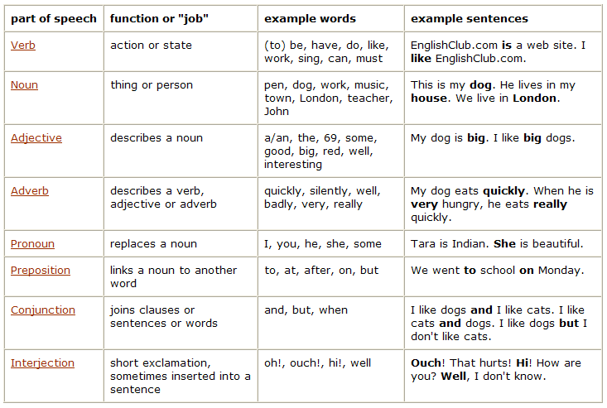
Part-of-Speech Table
http://www.englishclub.com/grammar/parts-of-speech_1.htm
Notes:
Articles (a, an, the) are adjectives

Slide 11
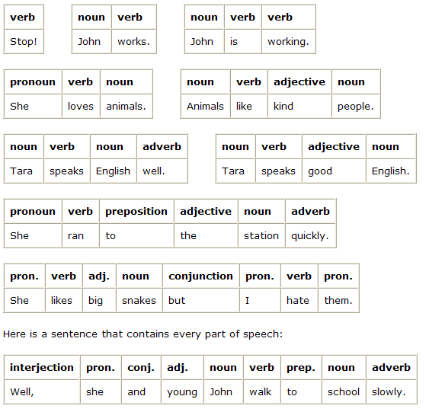
Part-of-Speech examples
http://www.englishclub.com/grammar/parts-of-speech_2.htm

Slide 12
Closed vs. Open Class Words
Closed class: relatively fixed set
Prepositions: of, in, by, …
Auxiliaries: may, can, will, had, been, …
Pronouns: I, you, she, mine, his, them, …
Usually function words (short common words which play a role in grammar)
Open class: productive
English has 4: Nouns, Verbs, Adjectives, Adverbs
Many languages have all 4, but not all!
12
Notes:
12

Slide 13
Open Class Words
Nouns
Proper nouns
Fordham University, New York City, Central Park, Metropolitan Transit Center
English capitalizes these
Many have abbreviations
Common nouns
All the rest
German capitalizes these.
Count nouns vs. mass nouns
Count: Have plurals, countable: goat/goats, one goat, two goats
Mass: Not countable (fish, salt, ..) (?two fishes)
What type of nouns are most popular search terms?
13
Notes:
13

Slide 14
Adjectives: identify properties or qualities of nouns
Color, size, age, …
Adjective ordering restrictions in English:
Old blue book, not Blue old book
In Korean, adjectives are realized as verbs
14
Notes:
14
Mass: is this singular or plural?

Slide 15
Adverbs: also modify things (verbs, adjectives, adverbs)
The very happy man walked home extremely slowly yesterday.
Directional/locative adverbs (here, home, downhill)
Degree adverbs (extremely, very, somewhat)
Manner adverbs (slowly, slinkily, delicately)
Temporal adverbs (tomorrow)
15
Notes:
15
Mass: is this singular or plural?

Slide 16
Verbs:
Represent actions (walk, ate), processes (provide, see), and states (be, seem)
In English, take morphological affixes (eat/eats/eaten)
Many subclasses, e.g.
eats/V ⇒ eat/VB, eat/VBP, eats/VBZ, ate/VBD, eaten/VBN, eating/VBG, ...
Reflect morphological form & syntactic function

Slide 17
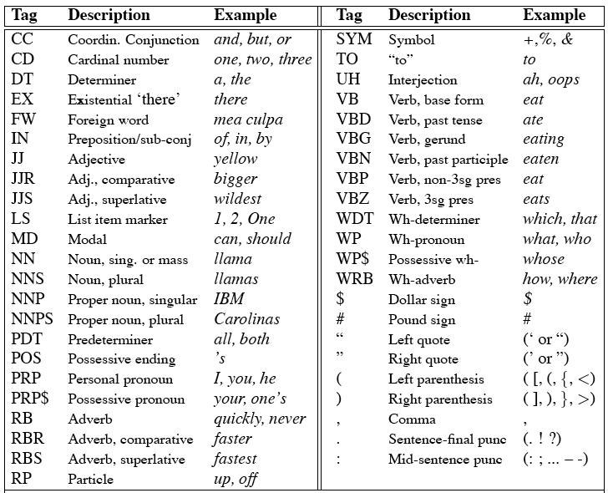
Penn Treebank Tagset
17
Notes:
17

Slide 18
Ambiguity
Fed raises interest rates.
Notes:
What makes this task hard?

Slide 19
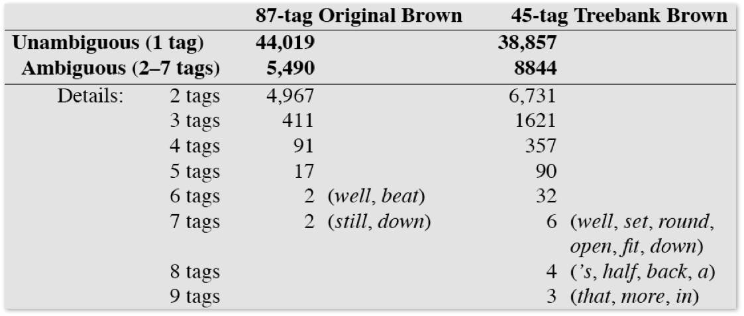
How many words are ambiguous?
Hockenmaier
Notes:
The main problem in the task of part of speech tagging is how to differentiate between the tags for ambiguous words

Slide 20
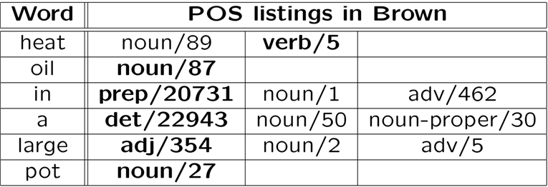
Simplest approach?
Pick the most common tag for the word
91% success rate!
Andrew McCallum

Slide 21
We have more information
We are not just tagging words, we are tagging sequences of words
For a sequence of words W:
W = w₁w₂w₃…w_{n}
We are looking for a sequence of tags T:
T = t₁ t₂ t₃ … t_{n}
where P(T|W) is maximized
Andrew McCallum

Slide 22
Bayes’ Rule
To find P(T|W), use Bayes’ Rule:
We can maximize P(T|W) by maximizing
P(W|T)*P(T)
Andrew McCallum
Notes:
? What is Bayes rule?
P(W) won’t change. Words don’t change.

Slide 23
What is a Markov model?

Slide 24
Process as a HMM
Start in an initial state t₀ with probability π(t₀)
Move from state t_{i} to t_{j} with transition probability a(t_{j}|t_{i})
In state t_{i}, emit symbol w_{k} with emission probability P(w_{k}|t_{i})
.02
.3
.3
Det
.47
Adj
.6
Noun
.7
Verb
.51
.1
P(w|Det)
P(w|Adj)
P(w|Noun)
a
.4
good
.02
price
.001
the
.4
low
.04
deal
.0001

Slide 25
Three Questions for HMMs
Evaluation – Given a sequence of words W = w₁w₂w₃…w_{n} and an HMM model Θ, what is P(W|Θ)
Tagging – Given a sequence of words W and an HMM model Θ, find the most probable parse T = t₁ t₂ t₃ … t_{n}
Learning – Given a tagged (or untagged) dataset, find the HMM Θ that maximizes the prob. of data
Notes:
1. Could predict next word?

Slide 26
Part-of-Speech Tagging
Training data (Annotated text)
This sentence serves as an example of annotated text…
Det N V1 P Det N P V2 N
“This is a new sentence.”
POS Tagger
This is a new sentence.
Det Aux Det Adj N
Pick the most likely tag sequence.
Independent assignment
Most common tag
Partial dependency
(HMM)
Notes:
POS Tagging attempts to label each word with the appropriate part of speech.
Past approaches were rule-based (manual, then learned). Current trend, however, is toward statistical approaches (HMM).
This shift is common throughout NLP, due to the ability of statistical approaches to robustly handle noise and/or unexpected events.
Conceptually statistical approaches are more fitting due to the fact that uncertainty is sometimes unavoidable (ambiguity).
Current algorithms (Brill’s Tagger, CLAWS taggers) report accuracy in the 97% range.

Slide 27
Sentence segmentation
“?” or “!” reliable indicators of sentence end
“.” ambiguous
Mr.
Ph.D.
I.B.M.
Can you think of an algorithm?
How to do in NLTK?
Can you think of a metric of sentence similarity?
“Minimum edit distance”
Notes:
Use regex (rule-based) OR train a classifier (ML)
Minimum # of edits to go from S1 to S2
Actions: Insert, Delete, Substitute (double cost)

Slide 28
There is more: Words work in groups
Constituents – words or groupings of words that function as single units
Noun phrases (NPs)
The computer science class
Peter, Paul, and Mary
PAC10 Schools, such as UW,
He
The reason I was late
Notes:
? How can you tell that something is a noun phrase

Slide 29
Syntax
Refers to the study of the way words are arranged together, and the relationship between them.
Goal of syntax is to model the knowledge of that people unconsciously have about the grammar of their native language
Prescriptive vs. Descriptive
Parsing extracts the syntax from a sentence
Notes:
? Pres vs desc?
That was an epic fail
Cs getting too mainstream ? Star trek intro: to boldly go where no man has gone before.
A precise way to define and describe the structure of sentences.

Slide 30
Sentence Parsing
We want to find possible structures for a sentence (run a grammar backwards)
Parsing can be viewed as a search problem
Parsing is a hidden data problem

Slide 31
Context-free grammars (CFGs)
Specifies a set of tree structures that capture constituency and ordering in language
A noun phrase can come before a verb phrase
S → NP VP
S
NP
VP

Slide 32
Formal definition of Grammar (CFG)
G = (T, N, S, R)
T is the set of terminals (i.e. words)
N is the set of non-terminals
S is the start symbol
R is the set of rules/productions of the form X → γ where X is a nonterminal and γ is a sequence of terminals and nonterminals (possibly empty)
A grammar G generates a language L
Manning
Notes:
Phrase structure grammars = Context-free grammars

Slide 33
A phrase structure grammar
By convention, S is the start symbol
S → NP VP NN → boy
NP → DT NN NNS → sports
NP → NNS NN → bruise
VP → V NP V → sports
VP → V V → likes
... DT → a
S
NP
VP
DT
NN
V
NP
But since a sentence can have more than one parse…
a
bruise
likes
sports

Slide 34
Probabilistic context-free grammars (PCFGs)
G = (T, N, S, R, P)
T is the set of terminals (i.e. words)
N is the set of non-terminals
S is the start symbol
R is the set of rules/productions of the form X → γ where X is a nonterminal and γ is a sequence of terminals and nonterminals (possibly empty)
P(R) gives the probability of each rule
A grammar G generates a language L
Manning

Slide 35
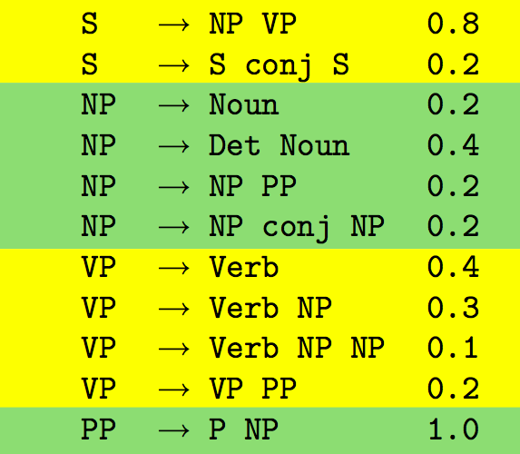
Finding P(τ)
Define probability distributions over the rules in the grammar
Context free!
Hockenmaier
Notes:
Context free!

Slide 36
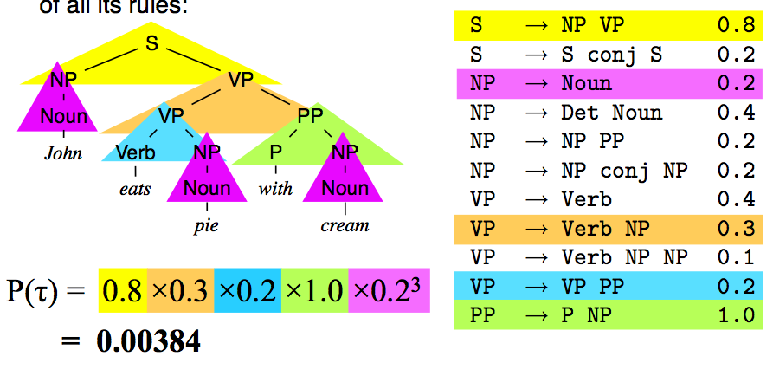
Finding P(τ)
The probability of a tree is the product of the probability of the rules that created it
Hockenmaier

Slide 37
Parse Tree
Choose most likely parse tree…
S
Probability of this tree=0.000015
Probabilistic CFG
NP
VP
S→ NP VP
NP → Det BNP
NP → BNP
NP→ NP PP
BNP→ N
VP → V
VP → Aux V NP
VP → VP PP
PP → P NP
V → chasing
Aux→ is
N → dog
N → boy
N→ playground
Det→ the
Det→ a
P → on
Det
1.0
BNP
VP
PP
0.3
0.4
0.3
A
N
Aux
V
NP
P
NP
Grammar
dog
is
chasing
on
…
a boy
.
the playground
.
…
.
S
Probability of this tree=0.000011
1.0
NP
VP
0.01
Det
BNP
Aux
V
NP
PP
0.003
A
N
is
chasing
NP
Lexicon
P
NP
…
dog
a boy
on
…
the playground
Notes:
Parsing attempts to infer the precise grammatical relationships between different words in a given sentence.
For example, POS are grouped into phrases and phrases are combined into sentences.
Approaches include parsing with probabilistic CFG’s, “link dictionaries”, and tree adjoining techniques (super-tagging).
Current techniques can only parse at the sentence level, in some cases reporting accuracy in the 90% range.
Again, the performance heavily depends upon the grammatical correctness and the degree of ambiguity of the text.

Slide 38
An Example
IBM/NNP Corp./NNP and/CC Alvarion/NNP Inc./NNP have/VBP established/VBN an/DT alliance/NN to/TO offer/VB wireless/JJ systems/NNS to/TO municipalities/NNS and/CC their/PRP$ public/JJ safety/NN agencies/NNS ,/, Alvarion/NNP announced/VBD ./.

Slide 39
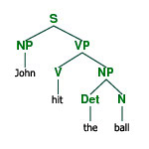
Parse Tree
Parsing provides maximum structural information per sentence
On the input we get a sentence, on the output we generate a parse tree
For most of the methods dealing with the text data the information in parse trees is too complex

Slide 40
Why Parsing?
High-precision Question-Answering systems
Named Entity Recognition (NER) and information extraction
Opinion extraction in product reviews
Improved interaction during computer applications/games
Notes:
Part of speech taggers and sentence parsers are freely available!
Useful in several applications…

Slide 41
Questions?
Thank you

Slide 42
Appendix

Slide 43

Natural Language Processing
A dog is chasing a boy on the playground
Det
Noun
Aux
Verb
Det
Noun
Prep
Det
Noun
Lexical/syntactic
analysis
(part-of-speech
tagging)
Noun Phrase
Noun Phrase
Complex Verb
Noun Phrase
Prep Phrase
Semantic analysis
Verb Phrase
Syntactic analysis
(Parsing)
Dog(d1).
Boy(b1).
Playground(p1).
Chasing(d1,b1,p1).
Verb Phrase
+
Sentence
Scared(x) if Chasing(_,x,_).
A person saying this may
be reminding another person to
get the dog back…
Scared(b1)
Inference
Pragmatic analysis
(speech act)
(Taken from ChengXiang Zhai, CS 397cxz – Fall 2003)
Notes:
NLP, or Computational Linguistics, is an entire field dedicated to the study
of automatically understanding free text. This field has been active since the 50’s.
General NLP attempts to understand document completely (at the level of a human reader).
There are several steps involved in NLP.
…Blah…

